Slide 1
Post Award Primer
I was awarded a grant! ….now what?
Office of Sponsored Programs; General Accounting
CETL Forum 12-Apr-2017

Slide 2
Who We Are
Sponsored Programs
Nicole Morse Grants & Contracts Administrator
Sally Goble Grants & Contracts Administrator
Cira Mathis
Associate Director
General Accounting
Matt Wills
Grant Fund Accountant
Noelle Sanchez Assistant Controller

Slide 3
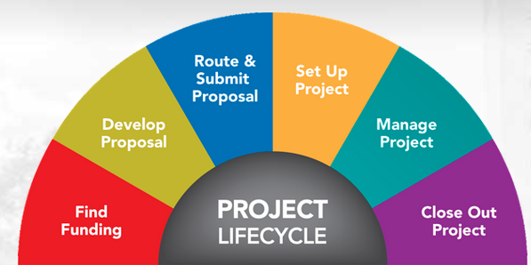
-Set up -Manage -Close out
Topics Covered Today

Slide 4

Topics Covered Today
A LOT…
…but may not be exhaustive coverage of everything applicable to each and every award. Work closely with OSP!

Slide 5
The Award
Award notices differ by funding agency
Terms and conditions vary by
mechanism type (grant; contract; cooperative agreement; PO)
sponsor type (federal; state; private)
program type (research; student services; instruction)
Terms and conditions may be spelled out directly in the award and/or incorporated by reference

Slide 6
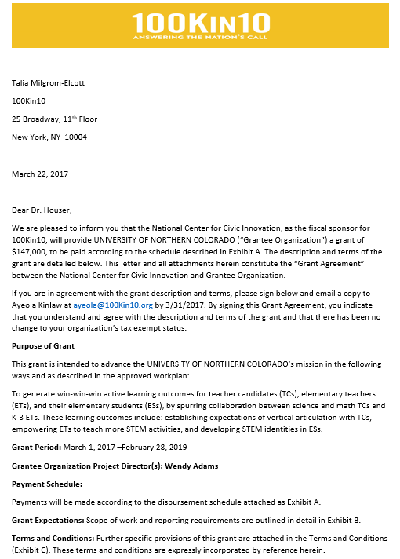

Slide 7
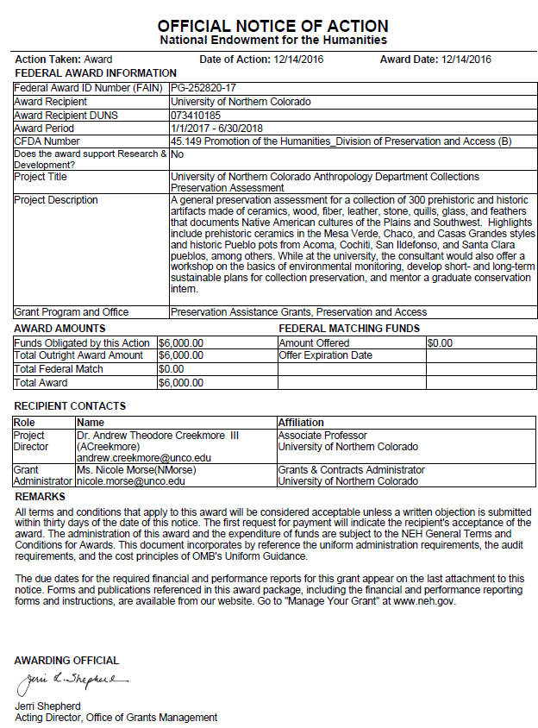

Slide 8
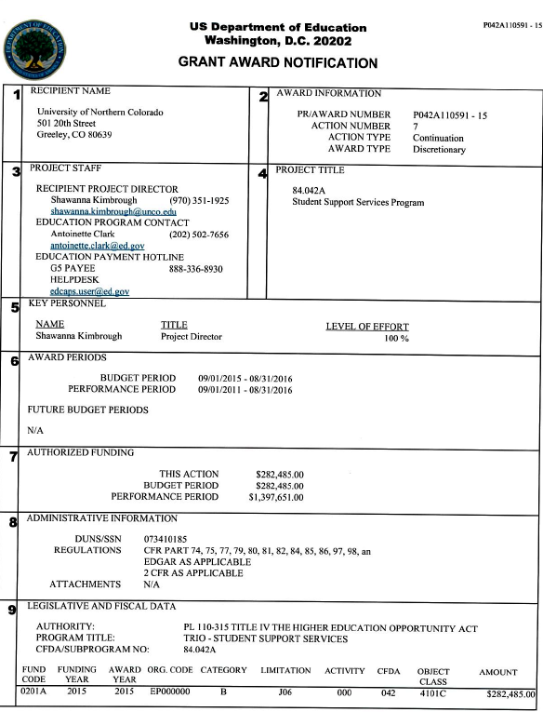
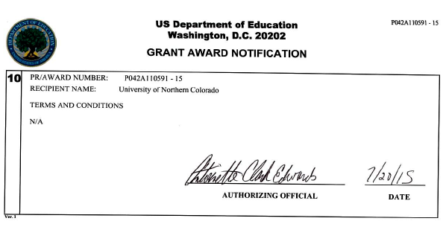

Slide 9
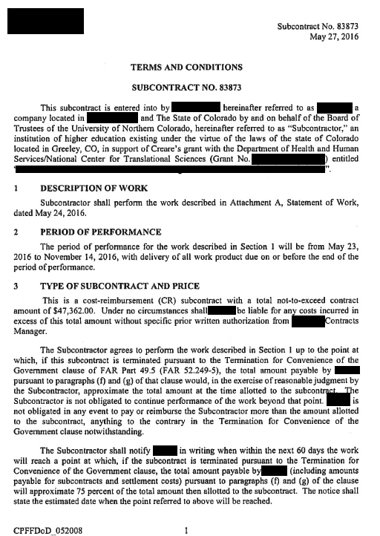

Slide 10
Conflicting Terms?
Order of Precedence
When there is a question about whether a federal rule applies to an award, the following order of precedence should be followed:
(1) Award-specific terms and conditions (2) Federal Agency’s program-specific terms and conditions (3) Federal Agency’s general terms and conditions (4) Uniform Administrative Requirements, Cost Principles, and Audit Requirements for Federal Awards (2 CFR 200)
ASK OSP!

Slide 11
Est. ‘Fund’ in Banner
Award Set-up
Approval Queue Authorization completed by OSP
Award Received
Approval Queue Authorization completed by OSP
Sent to GAO for processing
OSP requests Fund Number(s)
Fund Application completed by OSP
Fund App sent to PI/PD for signature
PI returns signed Fund App to GAO
Fund App sent to PI/PD for signature
Fund App sent to GAO (w/ Award & budget) for set-up
Fund App sent to PI/PD for signature

Slide 12
Award Set-Up
Kick-off Meeting
Not required, but strongly encouraged
Key attendees: GCA, GOA, PI, BM, other
Review key grant terms/conditions
Confirm approved budget, fund numbers
Discuss processes for certain costs (e.g.: labor; participant support; equipment; etc.)
Note all reporting dates; report formats
Review roles and responsibilities
Q&A

Slide 13
What Accounting Does
In the beginning…
Provide fund and grant number to OSP
Upon receiving fund application and documentation from OSP
Setup new award in Banner
Setup Indirect Costs
Enter budget in Banner
During your performance period…
Process Journal entries to adjust expense, as allowable
Approve all Pcard transactions on your grants
Approve all invoices paid on your grant
Monitor and request cash from your Federal sponsor
Invoice Non-Federal sponsors
Monitor your Indirect Cost (IDC) charges
Prepare and file all financial reports related to your grant (in collaboration with OSP & PI, as applicable)
Answer all financial questions
Near the end…
PI & Department analyze budgets and submit final expenses
Upon request, GAO moves expenses in or out of grant, based on allowability
Final IDC checks
Draw final cash on federal awards
Send out final invoices on non-federal awards
Close out fund, on request by OSP

Slide 14
Document Flow
What should be sent to
Grant Fund Accountant (GAO - Matt)
Journal Entries
PCard Statements (via A/P)
ACH/Check Requests (via A/P)
ALL Deposits to Restricted Funds
36 federal grant funds
35 federal grant funds
32 nonfederal grant funds
32 & 33 Foundation Funds
Any questions about invoices, charges or financial information
What should be sent to Grant & Contract Administrators (OSP - Nicole or Sally)
All Budget Change requests
All In-Kind Documents
All Labor Redistributions
Requests for No Cost Extensions (NCEs)

Slide 15
Cost Principles
Reasonableness (incl. Necessity)
reflect the action that a ‘prudent person’ would have taken under the circumstances prevailing when the decision to incur the cost was made;
recipient complied with its established organizational policies in incurring the cost or charge
Allocability
incurred solely in order to advance work under the grant;
chargeable or assignable to objective(s) in accordance with the relative benefits received or other equitable relationship
Consistency
recipients may be charged as either direct costs or F&A costs, depending on their identifiable benefit to a particular project or program, but all costs must be treated consistently for all work of the organization under similar circumstances, regardless of the source of funding
Conformance
limitations and exclusions as contained in the terms and conditions of award, including those in the cost principles-varies by the type of activity, the type of recipient, and other characteristics of individual awards

Slide 16
Cost Principles
…No ‘get out of jail free’ card “ These four tests apply regardless of whether the particular category of costs is one specified in the cost principles or one governed by other terms and conditions of an award. These tests also apply regardless of treatment as a direct cost or an F&A cost. The fact that a proposed cost is awarded as requested by an applicant does not indicate a determination of allowability. ”
--NIH Grants Policy Statement, 7.2 (rev. Nov2016)

Slide 17
Commonly Confused Costs

Slide 18
Students on Grants
Scholarship Support
For ‘Scholarship’ support, students NOT allowed to work for this funding
PI informs GCA in OSP that students have been identified for support
GCA requests applicable financial aid code from Financial Aid Office; prepares ‘Paying Grant-Funded Student Scholarships’ form header; routes to PI
PI completes student names and support details (tuition, stipend values, etc.); returns to GCA
GCA signs off and forwards completed form to Financial Aid for undergrads or Graduate School for graduate students

Slide 19
Working Students
Students on Grants
For Teaching Assistants, Graduate Assistants
PI’s unit initiates a TA or GA contract; routes to OSP GCA via Xtender
GCA reviews; provides financial aid code; signs and routes to Graduate School
Working 8-15 hours: requires grant to cover HALF of tuition and fees (on top of stipend)
Working 16-20 hours: requires grant to cover FULL tuition and fees (on top of stipend)

Slide 20
Participant Support Costs
Also known as: “PSC” ; “Trainee Costs”
2 CFR 200.75 ; 2 CFR 200.456
Allowable in connection with conferences or training projects, if permitted by the sponsor and specifically identified in the awarded budget Costs must be directly associated with and necessary to an individual’s training Must be accounted for separately (‘B fund’) from the rest of the awarded budget Re-budgeting these costs must have prior approval from the sponsor

Slide 21
Who is a participant?
Participant Support Costs
Non-UNC employee who is the recipient, not the provider, of a service or training associated with a workshop, conference, seminar, symposium or other short-term instructional or information sharing activity.
Participants do not perform work or services for the project or program unless it is for their own benefit.

Slide 22
PSC Classification Examples
Participant Support Costs
PSC | NOT PSC
Stipends Subsistence allowances Travel allowances Registration fees Materials for trainees | Research subject incentives UNC employee expenses Honoraria for speakers Payments to GRAs Project personnel travel to project meetings/conf.

Slide 23
UNC account codes: 72312 / 72313
Research Subjects Compensation
Compensation for time and inconvenience of participation in research studies
Monetary (cash, gift cards, vouchers, etc.) – General Accounting Gift Card Purchase Waiver Request http://www.unco.edu/purchasing/accounts-payable/
Non-monetary (gifts/promotional items, course credit, extra credit, etc.)
Must be expressly permitted by the grant terms and conditions
Compensation must be approved in advance by the Institutional Review Board (“IRB”) http://www.unco.edu/research/research-integrity-and-compliance/institutional-review-board/
Value of the compensation should be appropriate for the time and effort subjects devote to participation, and should not be high enough to cause coercion or undue influence.

Slide 24
Indirect Costs (F&A)
What are Indirect Costs in a Grant?
Indirect costs represent the expenses of doing business that are not readily identified with a particular activity, but are necessary for general operation of the organization.
Indirect costs are those costs that are not classified as direct costs.
Direct costs generally include:
Salaries & wages
Fringe benefits
Consultant services
Travel
Materials, supplies and equipment
What is the Indirect Cost Rate?
Federally negotiated rate – 37.00% for FY 2017
Varies by grant (often less than our negotiated rate)
IDC expense calculated by Banner and posted to grant fund monthly, as a percentage of direct costs
30% of IDC revenue distributed to College as “Research Incentive”

Slide 25
Budget Monitoring
Insight Report – GTR002
This report can provide summary or detail level data
Looks at life of grant
Rolls expenses into budget categories
Indirect Costs (IDCs) will affect your available budget, these are calculated monthly
Payroll is encumbered for the calendar year, even if you grant ends before December 31
Although there can be some flexibility between categories, the total amount to spend is not flexible
Will include expenses with incorrect Orgs
Has the ability to pull all funds tied to a Grant number (multiple funds, match funds etc.)
When in doubt ask, we are here to help

Slide 26
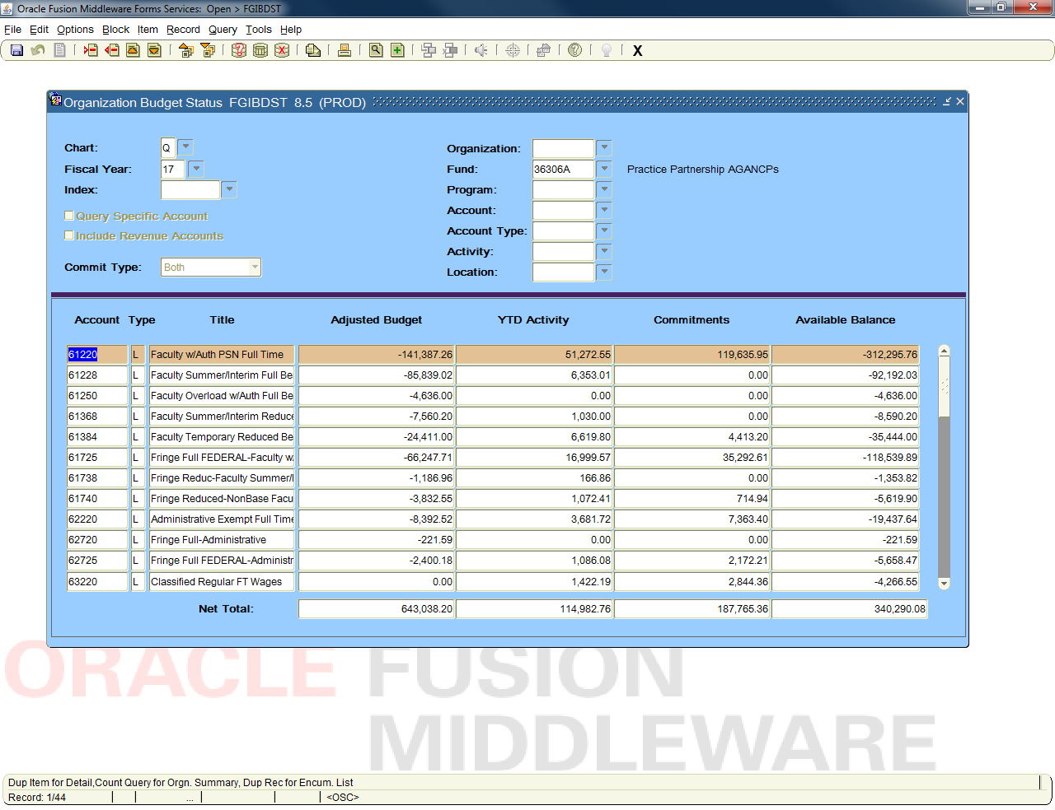
Useful UNC Reports
Banner
FGIBDST
Real time information
Looks only at a fiscal year
Budget does not line up with expense
Revenue is NOT cash
Payroll encumbered for entire calendar year
Expenses with wrong Org will not show in Banner

Slide 27
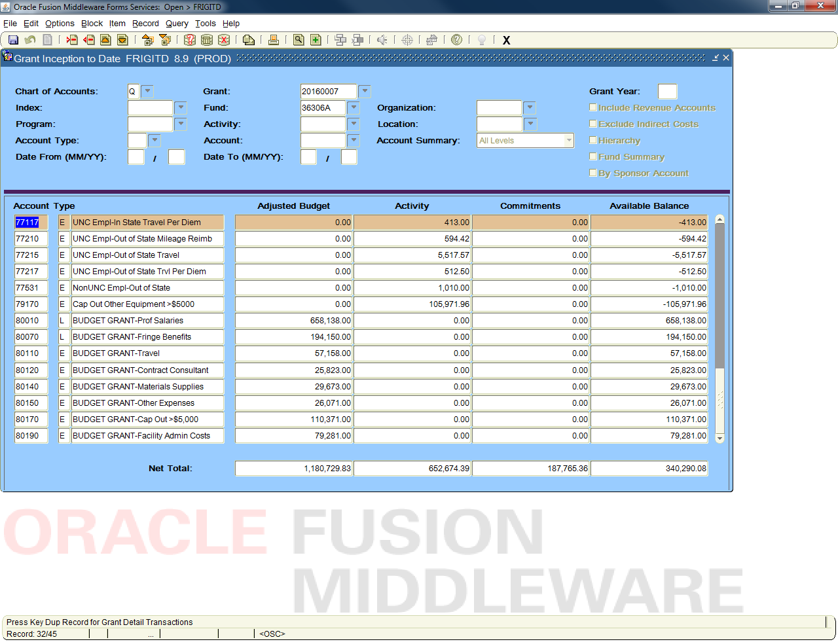
Useful UNC Reports
Banner
FRIGITD
Real time information
Looks at life of grant
Can pull all funds tied to Grant number (multiple funds, match funds, etc.)
Expenses with wrong Org will not show in Banner

Slide 28
Grant Reporting
Why?
Progress Reports
Allows sponsor to monitor the work accomplished compared to proposal
Communication of any problems, delays, changes that have may have been encountered or that are expected
‘Word is bond’? No. Put everything in writing, document, document, document (‘I called my program officer and…’)
Financial Reports
Allows sponsor to monitor your grant spending and cost share commitments
May include UNC’s request for future budget periods
Intellectual Property Reports (‘innovation disclosures’)
Bayh-Dole Act: universities may elect to retain title to innovations developed under federally-funded research programs
Government retains a non-exclusive license to practice the patent throughout the world (+ ‘march-in rights’)

Slide 29
Progress & Financial Reports
Who is responsible?
Progress Reports
PI will work with OSP on the budget narrative and schedules
Financial (expense) data provided by Grant Accounting, as applicable
PI writes narrative for work completed
PI or OSP submits, depending on award
Can be certified by the PI and/or OSP
Financial Reports
General Accounting will file invoices, Federal Financial Reports (FFRs), and other Financial Reports including quarterly, semi-annual, annual, and final
Can be collaborative process with PI & OSP
Normally submitted by GAO
In some specialty cases we will ask the PI to review the transactions and category totals prior to sending the report
During the reporting process we reconcile cash, expense, match and in-kind to budget
Financial reports will be certified by General Accounting, typically by the University Controller
Combined Reports
PI prepares information for the progress portion of the report and provides it to OSP
The GAO provides OSP with the required financial information
Usually submitted by OSP
Collaborative effort – start early!

Slide 30
Subrecipient Monitoring
Refer to CFR §200.331
Not a ‘set it and forget it’ arrangement
Monitoring framework initiated at Pre-Award stage, based on risk assessment; revisited and confirmed at Post-Award stage
Reporting frequency (progress; financial)
Backup documentation
Single audit receipt and review annually
Communication channels (PI to PI; OSP to OSP)
OSP working on tools to aid in monitoring efforts

Slide 31
Procurement Changes
Effective July 1, 2017
Note ‘Procurement Claw’ handout
Detailed training with the Procurement team, scheduled for April 24th at the UC

Slide 32
Prior Approvals
No-Cost Extension “NCE”
Purpose: to assure adequate completion of the original scope of work with funds already made available (not just to ‘spend down’ the grant funds)
Requires supporting reasons for the extension
Must be requested through OSP prior to current award end date
Time frame and review process is different for different sponsors – contact OSP to make the request early!
Some sponsors will not allow an extension if there are no remaining funds

Slide 33
Prior Approvals
Budget & Scope Changes
Budget adjustments
Typically allowed up to 25% variance between most budget categories, but varies by sponsor
Any change in participant support cost plans
May be result of scope change, which would also need sponsor’s prior approval
Scope adjustments
Addition of new collaborators; new subcontract
Change in major aims/objectives
Change in effort of any key personnel

Slide 34
Closeout
start as early as 120 days before end date!
Communicate with Stakeholders
Ensure PI, admins, purchasing, general accounting, and collaborators are all aware project is winding down and set to close on X date
No-cost extension?
Review Terms, Budget, Reporting Requirements
Check status of budget variances; make adjustments or prior approval requests as needed through OSP
Know and meet deadlines for final reports (financial, technical, inventions, equipment, etc.)
Any other deliverables? (Publications, Data, samples, recordings)
Ensure subawardees and contractors have their final reports in by X date (usually weeks ahead of prime awardee’s dates).

Slide 35
Closeout
Review Revenue and University Commitments
In-Kind and Cost Share commitments – ensure these have been met and document the proof
All subcontract invoices paid?
Invoice/drawdown final award funds from sponsor
Review Outstanding Expenses/Commitments, Note Impact on Budget, Take Corrective Action
Accounts Payable/Purchase Orders – review open amount; close as needed
Journal Entries – verify posted to GL
Ensure recurring payroll is set to cut off before grant end date (labor redistributions)
Very Last – inactivate fund number in Banner, file for record retention

Slide 36
Record Retention
Must keep all grant-related records for min. 7 years past the end date/closeout.
If grant is audited, records retention period is reset to 7 years from completion of audit
Record Type | Official ‘Keeper’ of Record
Financial Records | General Accounting
Proposal and Award Records | Sponsored Programs
Research Data | Principal Investigator

Slide 37
THANK YOU!
Questions? Comments? OSP: (970) 351-1907 Kepner 0025
Office of Sponsored Programs; General Accounting
CETL Forum 12-Apr-2017

